Slide 1

The DevOpsification of Windows Server
Jeffrey Snover Microsoft Technical Fellow
Chief Architect Enterprise Cloud Group
@JSNOVER

Slide 2

What is DevOps?

Slide 3
DevOps is about culture and processes

Slide 4
DevOps is NOT about tools and technology

Slide 5
But…..

Slide 6
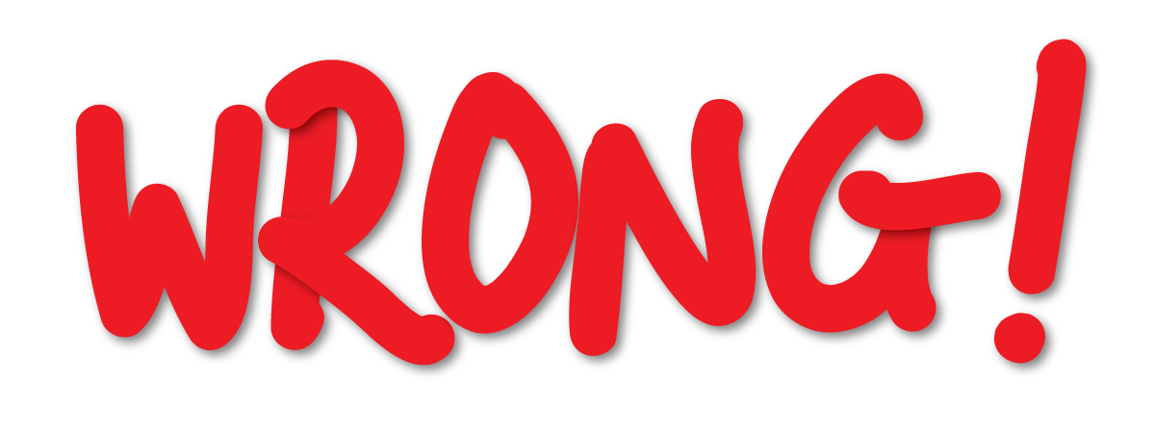
This is wrong

Slide 7

Tools and technology play a critical role

Slide 8
Tools and technology can make DevOps easy or hard

Slide 9
Windows Server 2016 is architected to make DevOps easy

Slide 10
Windows Server 2016 resolves the interface between devs and ops

Slide 11

Windows Server has been silent on the interface between Devs and Ops
No architecture
1,000 blossoms bloomed

Slide 12

1,000 conflicts also bloomed

Slide 13

WS2016 resolves that interface
Traditional ops model
Emerging ops model using Containers

Slide 14
Why?

Slide 15
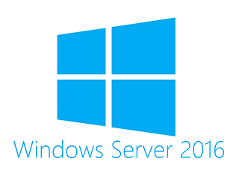
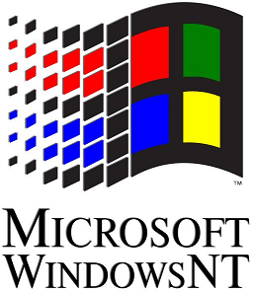
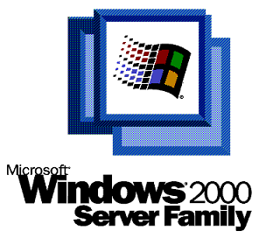
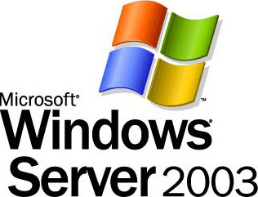

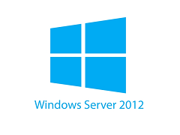
Evolution of Windows Server
Server for the Masses
Enterprise Servers
Datacenter Servers
Cloud Servers

Slide 16

Cloud Competitive
Small and fast
Minimize attack service
Minimize patches/reboots
Optimized for DevOps

Slide 17
Cloud + DevOps
Saving $ => Making $$$$$$$$

Slide 18
DevOpsification of Windows
Componentization
Development
Packaging & deployment
Configuration
Containers & Docker
Operational Validation Testing
Operating Securely

Slide 19
Componentization
Third-party applications
RDS experience
Traditional VM workloads
Containers and next-gen applications
Server And Desktop
Specialized workloads
Server Core
Lower maintenance server environment
Optimized for cloud infrastructure & next-gen distributed applications
Nano Server
Just enough OS

Slide 20
Nano Server: Optimized for the Cloud Era
Zero-footprint model
Server Roles and Optional Features live outside of Nano Server
Standalone packages that install like applications
Key Roles & Features
Clustering, Hyper-V, Storage (SoFS), and DNS Server
IIS, .NET Core, and ASP.NET Core
Full Windows Server driver support
Antimalware optional package
System Center VMM and OM agents available

Slide 21

Nano Server – PowerShell Core
Refactored to run on .NET Core
Full PowerShell language compatibility & remoting
Invoke-Command, New-PSSession, Enter-PSSession, etc.
Most core engine components
Support for all cmdlet types except workflow
C#, Script, and CIM
Limited set of cmdlets initially
Growing fast

Slide 22
DevOpsification of Windows
Componentization
Development
Packaging & deployment
Configuration
Containers & Docker
Operational Validation Testing
Operating Securely

Slide 23
Nano Server - Developer Experience
Nano Server has a full developer experience, unlike Server Core
Windows SDK & Visual Studio 2015 target Nano Server
Rich design-time experience
Project template, full IntelliSense, error squiggles, etc.
Full remote debugging experience

Slide 24
DevOpsification of Windows
Componentization
Development
Packaging & deployment
Configuration
Containers & Docker
Operational Validation Testing
Operating Securely

Slide 25

First a word about MSI
Not supported on Nano Server
MSI has GUI dependencies
Custom Actions are the portal to hell

Slide 26

Windows Server App installer (WSA)
New declarative Server installer
Extends the AppX schema
Allows for Server-specific extensions, such as NT Services, Perf Counters, COM Objects, WMI providers, ETW events
No custom actions
4 out of 5 kittens love WSA

Slide 27
PackageManagement
Cmdlet | ACTION
Find-Package | Search for a package
Install-Package | Install the package
Save-Package | Download the package but don’t install it
Get-Package | Inventory of installed packages
Uninstall-Package | Uninstall the package

Slide 28
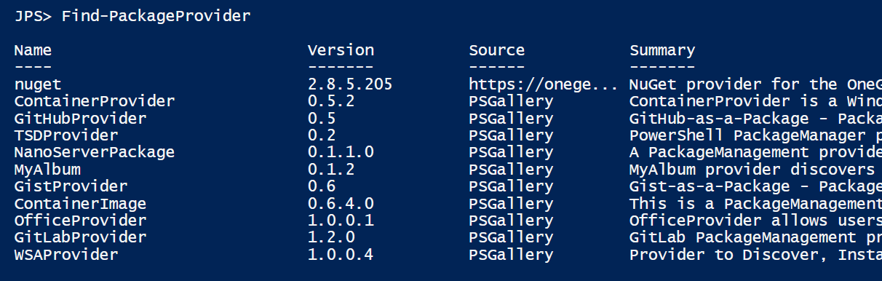

Slide 29
PackageManagement
End User
PackageManagement Core
Inventory
PackageManagement Providers
Windows Server App (WSA)
PowerShellGet
Discovery
Windows Container
NuGet
…
Package Sources
WSA Package Repository…
WordPress, …
PackageManagement PowerShell cmdlets
Install/Uninstall
PowerShell Gallery
NuGet Gallery …
Container Gallery, Docker
www.NPMjs.com
NanoServerPackage

Slide 30
DevOpsification of Windows
Componentization
Development
Packaging & deployment
Configuration
Containers & Docker
Operational Validation Testing
Operating Securely

Slide 31
Desired State Configuration
Cloud scale configuration management
Declare the state of a server (e.g User X should exist & be a member of the Adminstrator group )
Apply expert knowledge as common tasks – easier than scripting
DSC is the platform
Works in collaboration with DevOps tool chain (Chef, Puppet, etc.)
Windows 2008R2 and later, and Linux via OMI
Open source DSC Resource Kit (302) resources
https://gallery.technet.microsoft.com/scriptcenter/DSC-Resource-Kit-All-c449312d
DSC Overview
https://msdn.microsoft.com/en-us/powershell/dsc/overview

Slide 32
DevOpsification of Windows
Componentization
Development
Packaging & deployment
Configuration
Containers & Docker
Operational Validation Testing
Operating Securely

Slide 33
Running WS2016 Applications
Third-party applications
RDS experience
Traditional VM workloads
Containers and next-gen applications
Server And Desktop
Specialized workloads
Server Core
Lower maintenance server environment
Nano Server
Just enough OS

Slide 34

Operating System Deployment Modes
Physical hosts
Virtual hosts
Windows Server containers
Container must match host (i.e. Nano on Nano) will be relaxed in the future…
Hyper-V containers
Container must be Nano Server. Server Core support coming…
Host can be Nano Server, Windows Server Core or Windows Server w/Desktop
Container
Container
Container Host
Container Host
Nested Virtual Machine
Virtual Machine Host
Physical Server
Physical Server

Slide 35



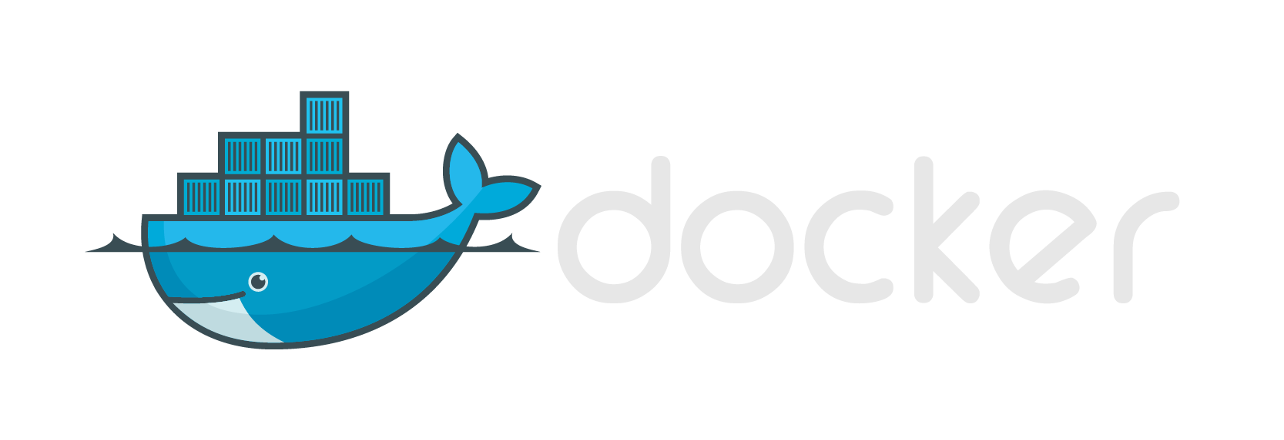


Same Container Images, Same API
Windows Container Images
Container Run-Times
Hyper-V Container
Container Management
Docker
Application
Framework
Windows Server Container
Write once, deploy anywhere

Slide 36
DevOpsification of Windows
Componentization
Development
Packaging & deployment
Configuration
Containers & Docker
Operational Validation Testing
Operating Securely

Slide 37
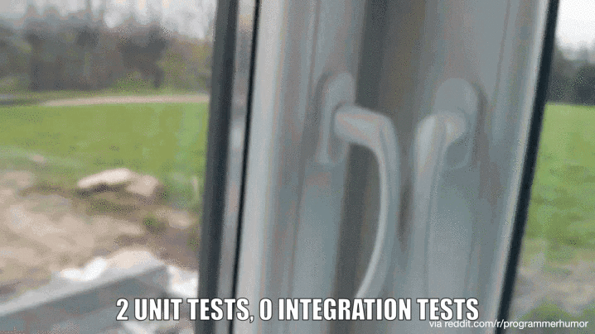

Slide 38
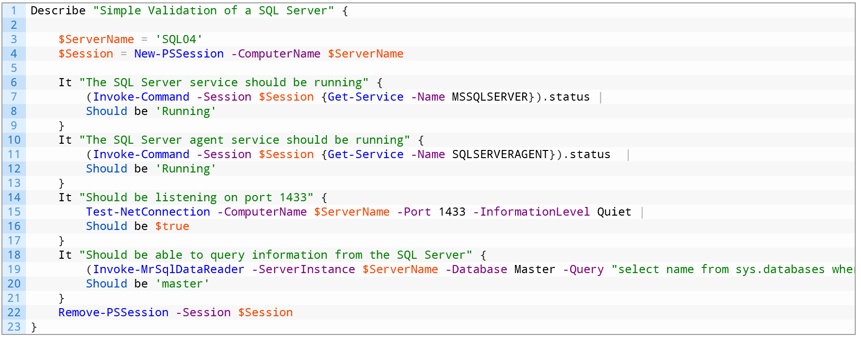

Slide 39
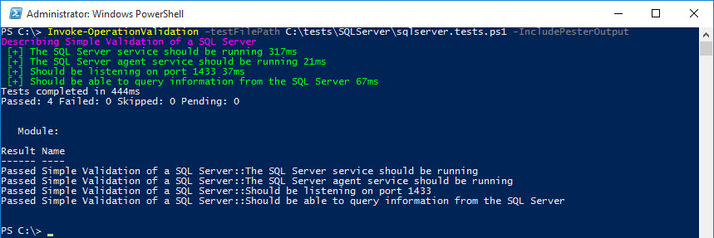

Slide 40
DevOpsification of Windows
Componentization
Development
Packaging & deployment
Configuration
Containers & Docker
Operational Validation Testing
Operating Securely

Slide 41


Problem: system admin privileges
Michael Hayden
Four star general
Director of the NSA
Director of the CIA
Director of National Intelligence
Edward Snowden
Age 30
College dropout
You’re an Admin
Thanks, you’re PWND!!
… but admins are often not suspected of criminal activity – they are simply targeted because they control access to networks the attacker wants to infiltrate. “Who better to target than the person that already has the ‘keys to the kingdom’?”

Slide 42
From full admin to role based admin
Just Enough Administration (JEA) using PowerShell WMF 5.0
On a Server - almost any administrative action requires a user be an administrator
Once an administrator, a user can do anything on the server with no oversight
A compromised machine or a breached administrator account enables attacker movement to other assets
Just Enough Admin
Allows you to perform administrative tasks without being a full administrator
Safe functions required by role
Dangerous functions attackers could abuse

Slide 43


Just Enough Administration (JEA)
HR Server
PS C:\> Enter-JEAsession Server1 –Name Maintenance
Server1> Restart-Service MSSQLSERVER
Server1> Steal-Secrets *
Error: You are not authorized to Steal-Secrets
JEA Resources:
https://github.com/PowerShell/JEA
https://gallery.technet.microsoft.com/Just-Enough-Administration-6b5ad370

Slide 44
DevOpsification of Windows
Componentization
Development
Packaging & deployment
Configuration
Containers & Docker
Operational Validation Testing
Operating Securely

Slide 45
Windows Server 2016 resolves the interface between devs and ops

Slide 46
DevOpsification of Windows
Componentization
Development
Packaging & deployment
Configuration
Containers & Docker
Operational Validation Testing
Operating Securely
WS2016
Available Downlevel

Slide 47
Cloud Competitive
Small and Fast
Minimize attack service
Minimize patches/reboots
Optimized for DevOps

Slide 48
Servicing Improvements*
23
26
11
23
6
9
8
3
2
* Analysis based on all patches released in 2014

Slide 49
Security Improvements
44
26
98
73
25
11

Slide 50
Resource Utilization Improvements
26
306
139
21
108
61

Slide 51
Deployment Improvements
300
5.42
6.3
40
.4
.41

Slide 52
DevOps is about culture and processes

Slide 53
Tools and technology can make DevOps easy or hard

Slide 54
Windows Server 2016 is architected to make DevOps easy

Slide 55

In times of change, sometimes the job outgrows good people

Slide 56
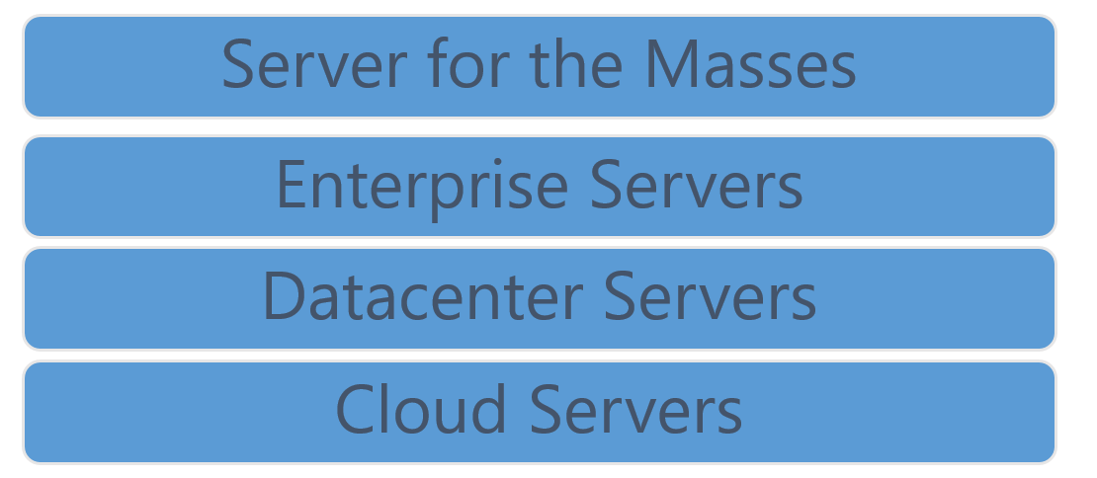
Where are you going? Do you have the right people, partners & tools to get there?

Slide 57

Q&A

